Slide 1

Food Buddy
Group 2
Kayann Potipitak, Catherine Dao, Jaylene Prom, Joseph Tran, Jessica Chau, Whitney Nguyen
Notes:
Kayann

Slide 2
TABLE OF CONTENTS
01
02
03
Introduction
06
Revenue Plans
Our Focus
07
Future Plans
Research
08
Demonstration
04
Competition
05
Our Services
Notes:
Kayann

Slide 3
INTRODUCTION
Problem Description:
The price of goods and services will increase over time...
Want to cook your own meal that is healthy, quick, and cheap
  No more greasy fast food or skipping meals
Search up food recipes
  Offers a large variety of healthy choices
Get recipe suggestions or ideas
  Use scan feature to track all user's available ingredients
Lacks some of the ingredients
  Show a grocery store nearby w/ ingredients at reasonable prices
Prepare meals more rapidly with recommended recipes
  Based on specific users’ interest and preferences
A mobile app for easy access anywhere at any time
Notes:
Catherine

Slide 4
OUR FOCUS
Health
Time
Money
Promote a healthy lifestyle by providing a wide variety of healthy recipes
Providing quick and efficient recipes based on foods on hand
Promote home-cooked meals rather than ordering food
Offer grocery price comparisons
Notes:
Whitney

Slide 5
RESEARCH
40%
56%
36%
Of the food supply is wasted.
Reported eating out at least 2 to 3 times per week.
Reported cooking at home on a daily basis.
Notes:
Jaylene

Slide 6
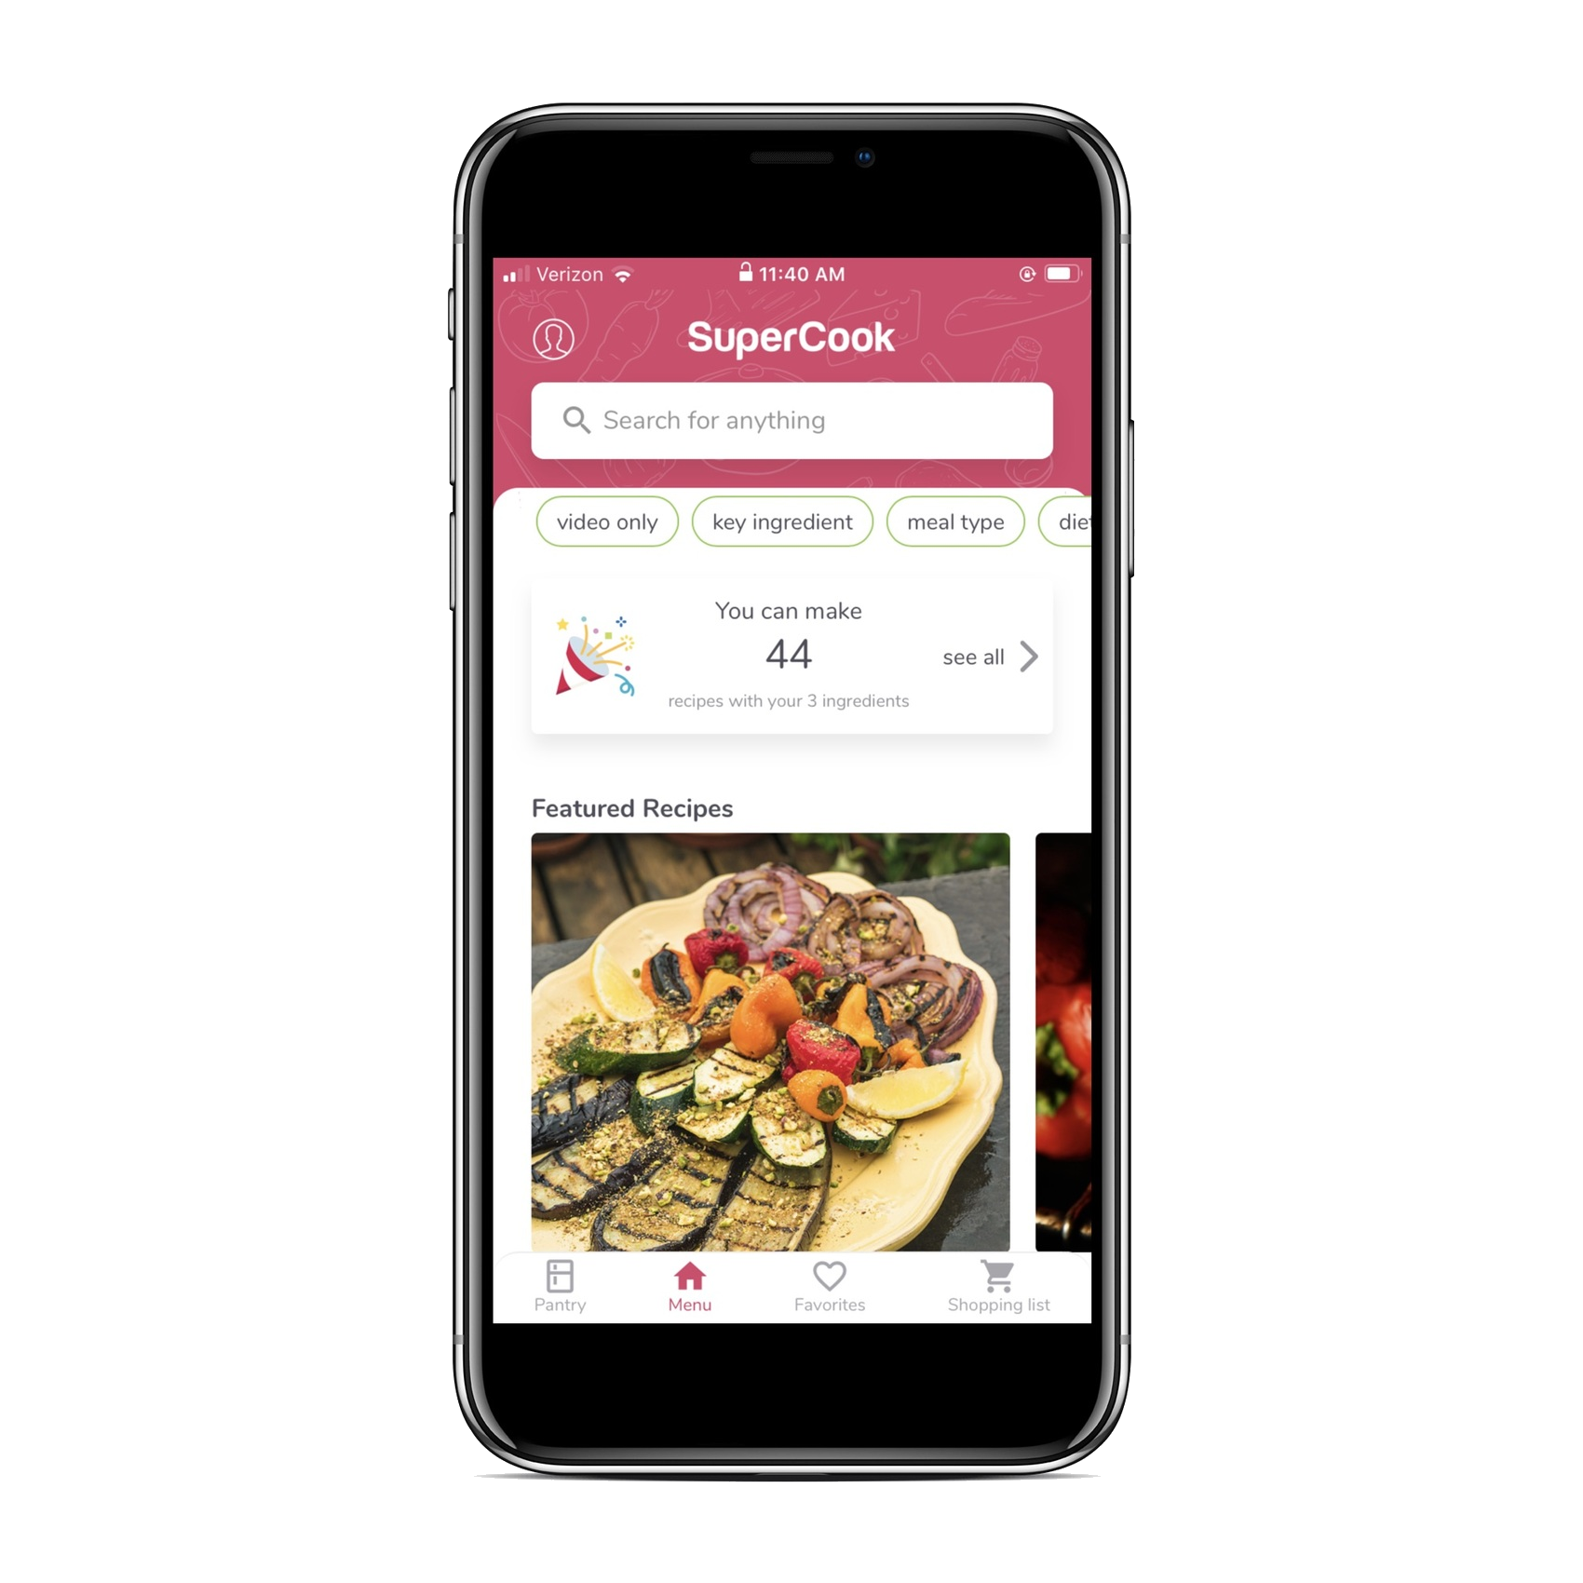
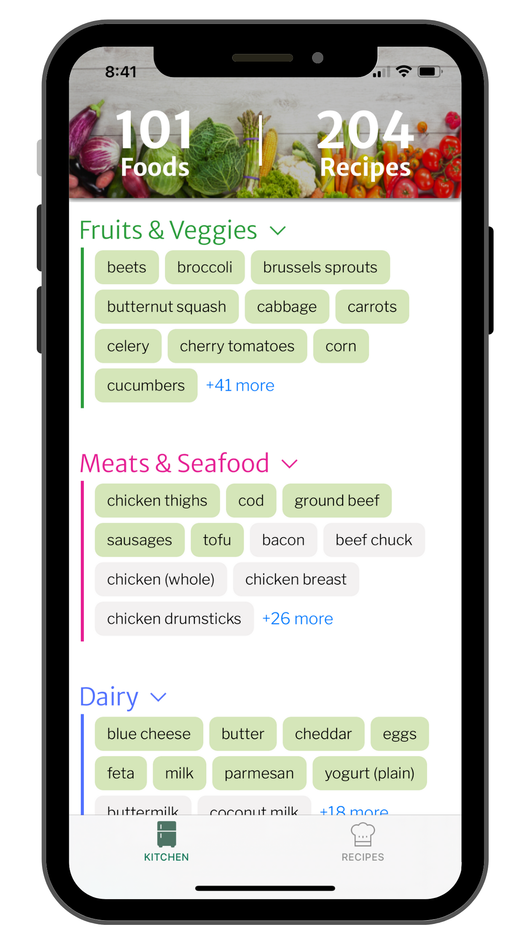
COMPETITION
SuperCook
Half Lemons
Notes:
Kayann

Slide 7
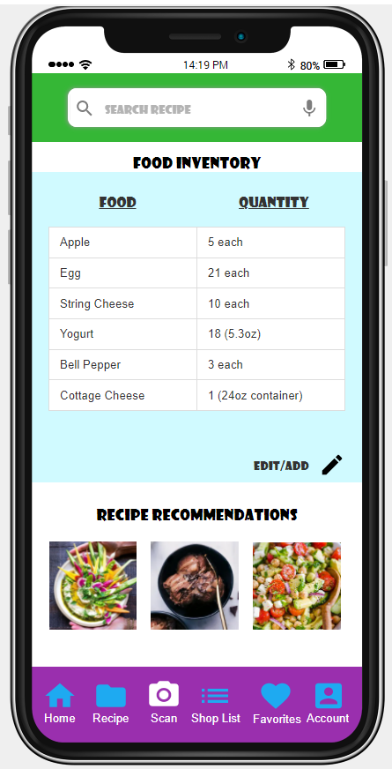
OUR SERVICES
Basic
Premium
PREMIUM
Scan fridge
Keep track of food inventory
Create shopping list
Grocery stores price comparisons
Easy and healthy recipes
Additional benefits:
Connect w/ nutritionist
Messaging capabilities
Service 1
Service 2
Service 3
$30.99
Notes:
Jessica

Slide 8
REVENUE PLANS
Grocery Store Partnerships
Premium Subscriptions
Collaborate with local well-known grocery stores to feature their store
Premium users pay a monthly subscription to enjoy premium benefits
50%
Blogger Partnerships
Advertisements
25%​
Ads can appear as featured/recommended products on our app
Recipes from food bloggers are recommended
15%​
10%​​
Notes:
Jaylene

Slide 9
FUTURE PLANS
More premium features
Build social media presence for marketing
Create a website for our application
Expand to more countries
Notes:
Catherine

Slide 10
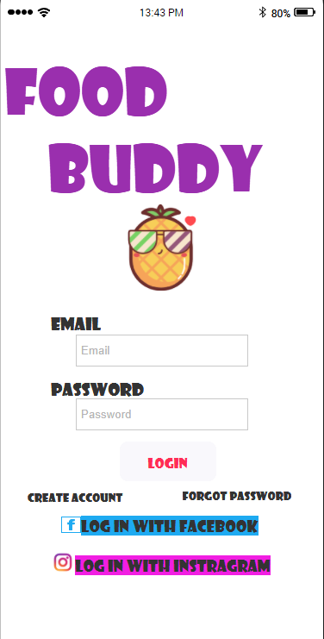
DEMONSTRATION
Notes:
Joseph

Slide 11
THANKS!
DO YOU HAVE ANY QUESTIONS?
FoodBuddy@gmail.com
+91 620 421 838

Slide 12
WORKS CITED
https://comfyliving.net/cooking-statistics/#:~:text=Key%20Cooking%20Statistics%20and%20Facts,and%20baking%20(46%25)%20more.
https://www.yahoo.com/now/people-eat-usually-eat-lot-172000757.html
https://www.usda.gov/foodwaste/faqs

